Slide 1
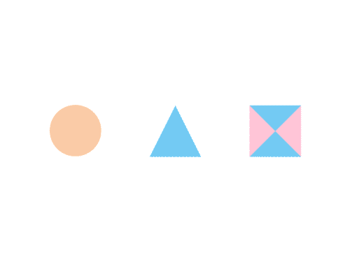

CSE 591 Overview and Detail
Ross Maciejewski
rmacieje@asu.edu

Slide 2
Problems of Scale
As our data sets get larger, the amount of screen space we have to display the data sets remains relatively the same
There may simply be too many things to display on the screen
Too many variables
Too many instances
May only be able to highlight particular cases or variables
Viewer’s focus may change from time to time to highlight new areas
This problem of scale is one of the fundamental challenges in visualization
How do we allow end-users to analyze a data set that is too large to fit in the display?

Slide 3
Overview
Remember the information visualization mantra, “Overview first, zoom and filter, details on demand”1
Providing an overview of the data set can be extremely helpful
This presents the user with ideas about the overall trends and patterns within the data
Assists users with navigation and search
It allows the user to orient there activities within a global framework

Slide 4
Details
In the information visualization mantra, we talk about “details on demand”
View want to examine details for individual cases and variables; however, we need techniques that allow help them find and focus on details of interest
In past lectures, we talked about the addition of machine learning and statistical analysis to help point out regions of interest

Slide 5
Transitioning Between Data Views
Many interfaces schemes exist that allow users to move between focused and contextual views of a data set
Can categorize these schemes into four sorts of approaches
Overview+detail
Uses a spatial separation between focused and contextual views
Zooming
Uses a temporal separation
Focus+Context
Displays focus within the context
Cue-Based
Selectively highlight/supress
A. Cockburn, A. Karlson, and B. Bederson, "A Review of Overview+Detail, Zooming, and Focus+Context Interfaces", ACM Computing Surveys, Vol. 41, No. 1, Dec. 2008, pp. 2:1-2:31.

Slide 6
Traditional Interface Mechanisms
Traditional mechanisms involve trade-offs between allowing information to be moved or spatially partitioned
Movement
Paging
Scrolling
Panning
Spatial
Windowing
Menus
While Windowing and Scrolling are standard in most interfaces, they introduce a discontinuity between the information displayed at different times and places
A. Cockburn, A. Karlson, and B. Bederson, "A Review of Overview+Detail, Zooming, and Focus+Context Interfaces", ACM Computing Surveys, Vol. 41, No. 1, Dec. 2008, pp. 2:1-2:31.

Slide 7
Traditional Interface Mechanisms
These discontinuities can cause cognitive and mechanical burdens for the user
User must mentally assimilate the overall structure of the information space
Reducing the discontinuity between views reduces the cognitive load by allowing rapid glances to check on information
GRUDIN, J. 2001. Partitioning Digital Worlds: Focal and Peripheral Awareness in Multiple Monitor Use. Proceedings of CHI'01: ACM Conference on Human Factors in Computing Systems, Seattle, Washington, 458-465.

Slide 8
Efficiency Measures
Interacting with a dataset requires a bit of thought in how the visualization should respond
Level of detail
Render items depending on how large they are on the screen
Don’t necessarily draw items below a certain size
Refinement
Render fast with low detail while moving, refine image when still
Region Management
Only update portion of screen that has been changed
Interruption
User input takes precedence, move animation to end state
Details from this slide taken from John Stasko’s Lecture on Overview + Detail: http://www.cc.gatech.edu/~stasko/7450/Notes/overdetail.pdf

Slide 9
Common Techniques
Pan and Scroll
Provides a larger virtual screen by allowing the user to move to different areas
Problem is that the interaction is a bit clunky
You only get to see one piece of the data as you pan around the data set
Details from this slide taken from John Stasko’s Lecture on Overview + Detail: http://www.cc.gatech.edu/~stasko/7450/Notes/overdetail.pdf

Slide 10
Overview+Detail
Overview + detail displays can be combined either through time or space
Time – alternate between overview and details sequentially in the same place
Space – use different portions of the screen to show overviews and details
Each approach has problems and advantages
Hybrid approaches also exist
The concept is to develop techniques to show viewers both overview + detail while allowing flexible alternation between each
Details from this slide taken from John Stasko’s Lecture on Overview + Detail: http://www.cc.gatech.edu/~stasko/7450/Notes/overdetail.pdf

Slide 11
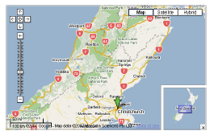
Overview+Detail
Overview+Detail interfaces are characterized by the simultaneous displays of both an overview and detailed view of an information space
Each view is in a distinct presentation space
Since views are physically separated, users can interact with both
A. Cockburn, A. Karlson, and B. Bederson, "A Review of Overview+Detail, Zooming, and Focus+Context Interfaces", ACM Computing Surveys, Vol. 41, No. 1, Dec. 2008, pp. 2:1-2:31.

Slide 12
Scrollbars
Position of the scroll thumb (or knob) in the scroll trough (or gutter) portrays your location in the document
Length of the scroll thumb shows the proportion of the visible document
Typically only embed spatial information, but researchers have tried other metaphors
Value bars¹-added dashed lines to the scroll trough to denote outliers in column formatted data files
Can add highlighting to scroll troughs to show passage similarity in documents²
1 - CHIMERA, R. 1992. ValueBars: An Information Visualization and Navigation Tool. Proceedings of CHI'92: ACM Conference on Human Factors in Computing Systems, Monterey, California, ACM Press, 293-294.
2 - HILL, W., HOLLAN, J., WROBLEWSKI, D. and MCCANDLESS, T. 1992. Edit Wear and Read Wear. Proceedings of CHI'92 ACM Conference on Human Factors in Computing Systems, Monterey, California, 3-9.

Slide 13
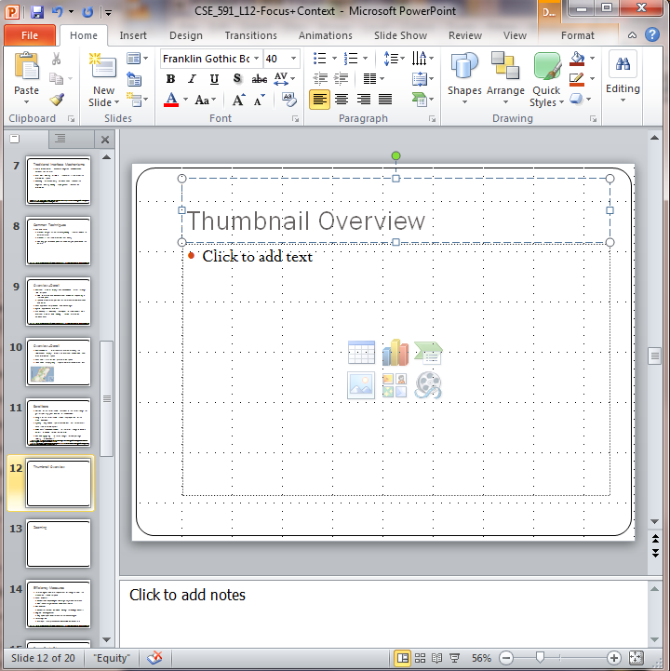
Thumbnail Overview
By increasing level of detail in scroll trough, the scrollbar becomes a first-class overview window
As level of detail increases, have to address trade-off in scale ratios
Low scale ratios allow thumbnails that clearly represent the underlying data set, but at the cost of increased overview scrolling to access distant thumbnails
A. Cockburn, A. Karlson, and B. Bederson, "A Review of Overview+Detail, Zooming, and Focus+Context Interfaces", ACM Computing Surveys, Vol. 41, No. 1, Dec. 2008, pp. 2:1-2:31.

Slide 14
Thumbnail Overview
Seems natural that thumbnails should allow shortcut navigation
Should the overview and detailed regions be synchronized?
Synchronization can prevent disorientation, but it is less powerful as it forbids independent exploration
PowerPoint implements a one-way synchronization (overview is synchronized with the detail view)
A. Cockburn, A. Karlson, and B. Bederson, "A Review of Overview+Detail, Zooming, and Focus+Context Interfaces", ACM Computing Surveys, Vol. 41, No. 1, Dec. 2008, pp. 2:1-2:31.

Slide 15
Standard Overview+Detail Views
overview
detail
Overview and detail (from Civilization II game)

Slide 16
Standard Overview+Detail Views
First examples seem to appear in video games as a means of providing an overview of the games information space
Google Maps utilizes a small inset regions for overview
Given the wide variety of application areas for overview+detail interfaces, it is unlikely that generic guidelines for the “right type” exist
However it is standard practice to allow interactive exploration of the overview without influencing the detail view
A. Cockburn, A. Karlson, and B. Bederson, "A Review of Overview+Detail, Zooming, and Focus+Context Interfaces", ACM Computing Surveys, Vol. 41, No. 1, Dec. 2008, pp. 2:1-2:31.

Slide 17
Lenses and Z-separation
Previous examples were with overview+detail separated in the x and y coordinates
Can also separate on the z coordinate with overview overlaying or blended into background
Lens are moveable display regions that are used to magnify details
A. Cockburn, A. Karlson, and B. Bederson, "A Review of Overview+Detail, Zooming, and Focus+Context Interfaces", ACM Computing Surveys, Vol. 41, No. 1, Dec. 2008, pp. 2:1-2:31.

Slide 18
Zooming
While Overview+Detail separated things through space, zooming separates things temporally
Users magnify (zoom in) or demagnify (zoom out) rather than seeing both views at once
Can also combine zoom and overview+detail
For our purposes, we will discuss zoom separately to highlight design issues
A. Cockburn, A. Karlson, and B. Bederson, "A Review of Overview+Detail, Zooming, and Focus+Context Interfaces", ACM Computing Surveys, Vol. 41, No. 1, Dec. 2008, pp. 2:1-2:31.

Slide 19
Zooming
For some applications, all mouse clicks and drags are interpreted as zoom actions when in chosen zoom mode
Some interfaces support zoom through specific interactions (double click, scrollwheel, ctrl++)
Problem is user has to discover how to activate zoom function
May be unable to reverse zoom action
How do you zoom in on Google maps? Zoom out?
Problem is exacerbated by the fact that ‘undo’ typically reserved for actions that modify the data state
A. Cockburn, A. Karlson, and B. Bederson, "A Review of Overview+Detail, Zooming, and Focus+Context Interfaces", ACM Computing Surveys, Vol. 41, No. 1, Dec. 2008, pp. 2:1-2:31.

Slide 20
Zooming
Geometric zooming – view depends on the physical properties of what is being viewed
Semantic zoom – gives different representations for different spatial scales of the data
Does not only change parameters of a graphical representation, but modifies the selection and structure of the data being displayed
First introduced in the Pad system (first fully zoomable desktop environment)
PERLIN, K. and FOX, D. 1993. Pad: An Alternative Approach to the Computer Interface. Proceedings of the 20th annual conference on Computer graphics and Interactive techniques, ACM Press, 57-64.

Slide 21
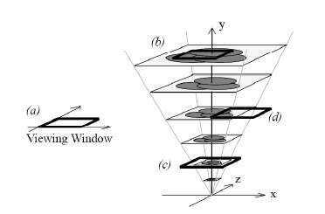
Space-Scale Diagram
FURNAS, G. W. and BEDERSON, B. B. 1995. Space-Scale Diagrams: Understanding Multiscale Interfaces. Proceedings of CHI'95: ACM Conference on Human Factors in Computing Systems, Denver, Colorado, ACM Press, 234-241.

Slide 22
Issues in Zooming
Desert Fog - As you zoom into your data, it is easy to get disoriented or lost due to separation at high zoom levels
Critical Zones – Cue based technique for overcoming desert fog
Idea is to demarcate your regions that are guaranteed to yield information when zoomed
Other suggestions were to link interaction such that it is impossible to navigate to empty data regions
1 - JUL, S. and FURNAS, G. 1998. Critical Zones in Desert Fog: Aids to Multiscale Navigation. Proceedings of UIST'98: ACM Symposium on User Interface Software and Technology, San Francisco, California, 97-106.
2 - BEDERSON, B. 2001. PhotoMesa: A Zoomable Image Browser Using Quantum Treemaps and Bubblemaps. Proceedings of UIST01: ACM Symposium on User Interface Software and Technology, Orlando, Florida, ACM Press, 71-80.

Slide 23
PhotoMesa
Examples of panning and zooming to browse a photo collection
http://www.windsorinterfaces.com/photomesa-demo/photomesa-demo-swf/photomesa-demo-swf.html

Slide 24
Animation in Zoom
Some zoom methods jump the user immediately to a new zoom level
However, animation can be used to help users assimilate the relationship between pre- and post-zoom states
Animation does a brief period of automatic zooming where the user just observes
Need to find a suitable transition speed that reveals the relationship between states without slowing user interaction
Research suggests values between .3 and 1.0 seconds
Van Wijk and Nuij presented formulae to calculate smooth and efficient trajectories for motion between known points
Cockburn, A. Karlson, and B. Bederson, "A Review of Overview+Detail, Zooming, and Focus+Context Interfaces", ACM Computing Surveys, Vol. 41, No. 1, Dec. 2008, pp. 2:1-2:31.
VAN WIJK, J. and NUIJ, W. 2004. A Model for Smooth Viewing and Navigation of Large 2D Information Spaces. IEEE Transactions on Visualization and Computer Graphics 10(4): 447-458.

Slide 25
Parallel Zooming
Most information browsing (however) involves dynamic querying and path modification
Traditional interfaces impose a temporal separation between user’s panning and zooming actions
Some systems allow for parallel zooming
Pan with one hand, zoom with another
Map vertical mouse movements to pan, horizontal to zoom¹
Some systems try to automatically connect pan and zoom based on manipulation between the two²
Combining zooming and panning may impede a user’s ability to understand the information space
1 - APPERT, C. and FEKETE, J. 2006. OrthoZoom Scroller: 1D Mutli-scale navigation. Proceedings of CHI'06: ACM Conference on Human Factors in Computing Systems, Montreal, Canada, ACM Press, 21-30.
2 - MACKINLAY, J., CARD, S. and ROBERTSON, G. 1990. Rapid Controlled Movement Through a Virtual 3D Workspace. Proceedings of SIGGRAPH '90: Computer Graphics, Dallas, Texas, ACM Press, 171-176.

Slide 26
Focus+Context
Overview+Detail separates exploration in space
Zooming separates exploration in time
Focus+Context integrates them into a single display where all parts are concurrently visible
Goal is to have all parts be concurrently visible
Also referred to as ‘distortion-oriented view’
Goal is to decrease the short term memory load associated with assimilating distinct views of a system
In this way, one can improve the user’s ability to comprehend and manipulate the information
A. Cockburn, A. Karlson, and B. Bederson, "A Review of Overview+Detail, Zooming, and Focus+Context Interfaces", ACM Computing Surveys, Vol. 41, No. 1, Dec. 2008, pp. 2:1-2:31.

Slide 27
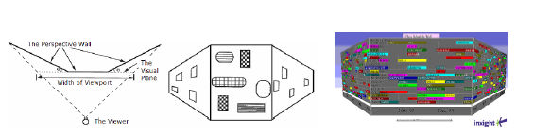
Focus+Context
First focus+context visualization was the ‘bifocal display’¹
Utilized a metaphor of a paper stretched across four rollers
User changed focus by sliding the paper in either direction across the frame
Later implemented at the Perspective Wall²
1 - SPENCE, R. and APPERLEY, M. 1982. Database Navigation: An Office Enironment for the Professional. Behaviour and Information Technology 1(1): 43-54.
2 -MACKINLAY, J., ROBERTSON, G. and CARD, S. 1991. Perspective Wall: Detail and Context Smoothly Integrated. Proceedings of CHI'91: ACM Conference on Human Factors in Computing Systems, New Orleans, 173-179.

Slide 28
Fisheye Theoretical Foundations
The theoretical foundations for focus+context interfaces were established by Furnas (1986)
Described a “generalised fisheye view” formula for calculating the user’s ‘degree of interest’ (DOI) in objects in the data-space
DOI(x | y) = API(x) – D(x,y),
where x is a data element, y is the current focus, API(x) is the a priori interest in object x, and D(x,y) is the spatial or semantic distance between x and y.
Furnas described how his formula could be applied to a variety of information domains, with data objects being removed from the display when they fell below a threshold DOI value.
FURNAS, G. 1986. Generalized Fisheye Views. Proceedings of CHI'86: ACM Conference on Human Factors in Computing Systems, Boston, MA, ACM Press, 16-23.

Slide 29
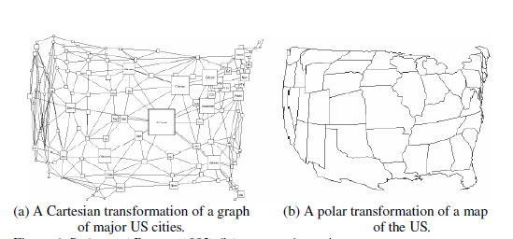
Fisheye Theoretical Foundations
While Furnas’s DOI formula determines what information should be included in the display, much of the subsequent research has focused on how information is presented
Further transformations to fisheye views
Geometric transformations that distort space based on the Euclidean distance between vertices and a user’s focal point
SARKAR, M. and BROWN, M. 1992. Graphical Fisheye Views of Graphs. Proceedings of CHI'92: ACM Conference on Human Factors in Computing Systems, Monterey, CA, ACM Press, 83-91.

Slide 30
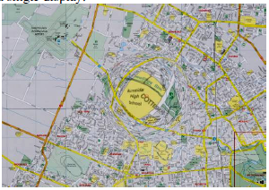
Potential Problems with Fisheye
User’s can misinterpret the underlying data
User’s have a hard time in target acquisition due to the distortion of the information space
A. Cockburn, A. Karlson, and B. Bederson, "A Review of Overview+Detail, Zooming, and Focus+Context Interfaces", ACM Computing Surveys, Vol. 41, No. 1, Dec. 2008, pp. 2:1-2:31.

Slide 31
Cue-Based
Previous approaches described modify the size of objects in order to support both focused and contextual views
Scale modifications can be applied purely to the graphical portrayal of objects or semantically
Cue-based techniques modify how objects are rendered and can introduce proxies for objects that might not be expected to appear in the display at all
Can be used in conjunction with previously mentioned schemes
Typically applied in response to some search criteria
Data items satisfying search are then displayed in a modified form to alert the user to their presence
A. Cockburn, A. Karlson, and B. Bederson, "A Review of Overview+Detail, Zooming, and Focus+Context Interfaces", ACM Computing Surveys, Vol. 41, No. 1, Dec. 2008, pp. 2:1-2:31.

Slide 32
Cue-Based
Need to give strong consideration to the ‘information scent’
Strength of local cues, text labels, etc.
These cues give an indication of the utility of a navigational path leading to information
A. Cockburn, A. Karlson, and B. Bederson, "A Review of Overview+Detail, Zooming, and Focus+Context Interfaces", ACM Computing Surveys, Vol. 41, No. 1, Dec. 2008, pp. 2:1-2:31.

Slide 33
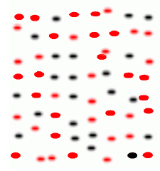
Cue Techniques for Highlighting Object
Sematic depth of field
Provides a natural interface for drawing user’s attention to focal items
Items that satisfy your search criteria are in focus, otherwise, items are out of focus
KOSARA, R., MIKSCH, S. and HAUSER, H. 2002. Focus+Context Taken Literally IEEE Computer Graphics and Applications 22(1): 22-29.

Slide 34
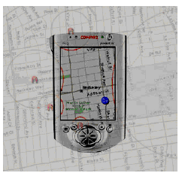
Cue Techniques for Extending Bounds
Contextual cues about information lying outside the main display region can also be added
Some ideas were to add ‘decorations’
City lights interface used window-edge decorations to indicate the existence, size and/or location of objects that lay beyond the window frame
ZELLWEGER, P., MACKINLAY, J., GOOD, L., STEFIK, M. and BAUDISCH, P. 2002. City Lights: Contextual Views in Minimal Space. Extended Abstracts of CHI '02: ACM Conference on Human Factors in Computing Systems, Minneapolis, Minnesota, 838-839.

Slide 35
Evaluation
We develop these controls to improve performance, but which ones work?
Document navigation. Thumbnail-enhanced scrollbars (O+D) and several zooming variants are outperformed by a zooming interface that presents all pages as a stamp-sheet of page-thumbnails.
Steering tasks (dragging through a constrained path). Results showed that O+D and pan+zoom were slow compared to several fisheye variants..

Slide 36
Evaluation
Mechanical aspects of multi-scale searching. Compared O+D, pan and zoom, fisheye F+C, and DragMag interfaces for identifying abstract tasks. O+D performed best, followed by DragMag, F+C, then pan and zoom.
Multi-point target acquisition. Compared pan, zoom, and two fisheye techniques for selecting pairs of points. A fisheye allowed fastest task completion. Combined zooming and panning was not allowed.

Slide 37
Evaluation
Target acquisition. Describes the fisheye moving target problem, and proposes and evaluates ‘speed-coupled flattening’ which eases it.
Menu item acquisition. Analyses menu item selection with fisheye menus. Demonstrates they are slower than traditional hierarchical menus.

Slide 38
Detail Only
Single window with horizontal and vertical panning
Works only when zoom factor is relatively small
Example: Windows
Details from this slide taken from John Stasko’s Lecture on Overview + Detail: http://www.cc.gatech.edu/~stasko/7450/Notes/overdetail.pdf

Slide 39
Single Window with Zoom and Replace
Global view with selectable zoom area which then becomes entire view
Variations can let users pan and adjust zoomed area and adjust levels of magnification
Context switch can be disorienting
Example: CAD/CAM
Details from this slide taken from John Stasko’s Lecture on Overview + Detail: http://www.cc.gatech.edu/~stasko/7450/Notes/overdetail.pdf

Slide 40
Single Coordinated Pair
Combined display of the overview and local magnified view (separate views)
Some implementations reserve large space for overview; others for detail
Issue: How big are different views and where do they go?
Details from this slide taken from John Stasko’s Lecture on Overview + Detail: http://www.cc.gatech.edu/~stasko/7450/Notes/overdetail.pdf

Slide 41
Tiled Multilevel Browser
Combined global, intermediate, and detail views
Views do not overlap
Good implementations closely relate the views, allowing panning in one view to affect others
Details from this slide taken from John Stasko’s Lecture on Overview + Detail: http://www.cc.gatech.edu/~stasko/7450/Notes/overdetail.pdf

Slide 42
Free Zoom and Multiple Overlap
Overview presented first; user selects area to zoom and area in which to create detailed view
Flexible layout, but users must perform manual window management
Details from this slide taken from John Stasko’s Lecture on Overview + Detail: http://www.cc.gatech.edu/~stasko/7450/Notes/overdetail.pdf

Slide 43
Bifocal Magnified
“Magnifying glass” zoomed image floats over overview image
Neighboring objects are obscured by the zoomed window
Details from this slide taken from John Stasko’s Lecture on Overview + Detail: http://www.cc.gatech.edu/~stasko/7450/Notes/overdetail.pdf

Slide 44
Fish-Eye View
Magnified image is distorted so that focus is at high magnification, periphery at low
All in one view
Distortion can be disorienting
Details from this slide taken from John Stasko’s Lecture on Overview + Detail: http://www.cc.gatech.edu/~stasko/7450/Notes/overdetail.pdf

Slide 45
Readings and Homework
Required Reading:
A. Cockburn, A. Karlson, and B. Bederson, "A Review of Overview+Detail, Zooming, and Focus+Context Interfaces", ACM Computing Surveys, Vol. 41, No. 1, Dec. 2008, pp. 2:1-2:31
C. Plaisant, D. Carr, and B. Shneiderman, "Image-Browser Taxonomy and Guidelines for Designers", IEEE Software, Vol. 12, No. 2, pp. 21-32, March 1995.
Homework
Milestone #2 and Homework #4 are due Wednesday!
Midterm is in 10 days!

